Slide 1
Hate speech detection and Sms spam detection
Using data science
K. Shanmukh
Y20AIT451
4/4 IT-A

Slide 2
CONTENTS
ABSTRACT
EXIXTING SYSTEM
PROPOSED SYSTEM
FLOWCHART
CONCLUSION

Slide 3
ABSTRACT
Hate speech detection:
Sms spam detection:
Hate speech detection through data science leverages machine learning algorithms to analyze textual content, identifying and mitigating offensive language based on attributes such as race, religion, or gender, fostering safer and more inclusive online environments.
SMS spam detection using data science involves training models on labeled datasets to identify and filter unwanted messages. Techniques like text analysis and machine learning enable accurate classification, enhancing user experience and privacy.

Slide 4

EXIXTING SYSTEM Hate speech detection:
Perspective API by Jigsaw
a technology incubator created by Google.
It employs machine learning to identify and filter online content that includes hate speech.

Slide 5

EXIXTING SYSTEM Sms spam detection:
Apache SpamAssassin for SMS
widely used open-source spam filter.
The system uses various techniques,
including statistical analysis and machine learning,
to identifyand filter out spam messages.

Slide 6
PROPOSED SYSTEM
Hate speech detection:
When proposing a system for hate speech detection using data science, it's important to consider various aspects, including data collection, feature engineering, model selection, and evaluation metrics.
Aspects:
Data collection:
twitter data set

Slide 7
Aspects:
Feature engineering:
decision trees
Model selection:
Naive Bayes
Logistic Regression
Support Vector Machines (SVM)
Evaluation metrics:
precision,
recall,
F1-score.

Slide 8
PROPOSED SYSTEM
Sms spam detection:
When proposing a system for sms spam detection using data science, it's important to consider various aspects, including data collection, feature engineering, model selection, and evaluation metrics.
Aspects:
Data collection:
twitter data set

Slide 9
Aspects:
Feature engineering:
The code utilizes the NLTK library for text processing, including cleaning and tokenization.
removes non-alphabetic characters, converts text to lowercase, and applies lemmatization.
Model selection:
Multinomial Naive Bayes (MNB)
decision tree
Evaluation metrics:
F1 Score
Classification Report
Confusion Matrix

Slide 10
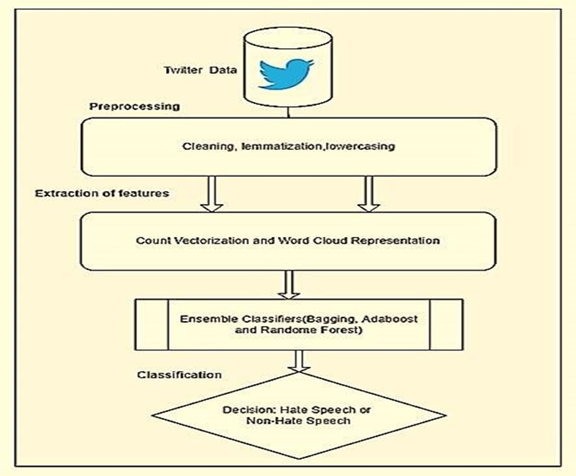
FLOWCHART
Hate speech detection:

Slide 11
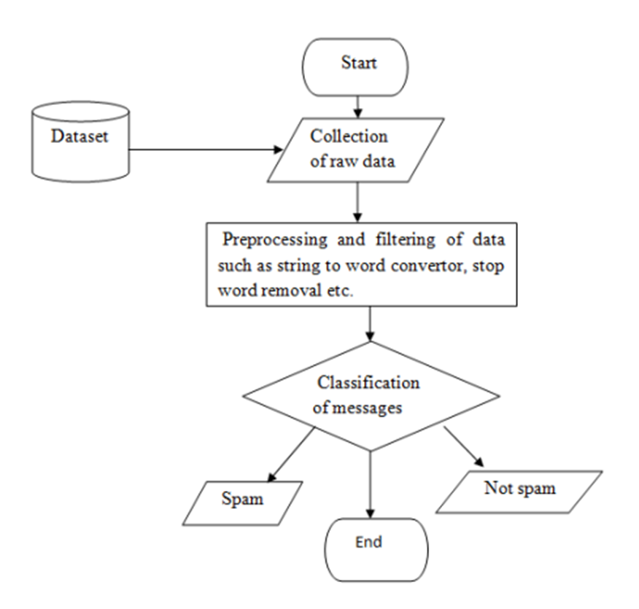
FLOWCHART
Sms spam detection:

Slide 12
CONCLUSION
In conclusion, data science proves instrumental in hate speech and SMS spam detection. Through advanced algorithms, feature engineering, and model evaluation, it empowers accurate identification. These applications not only enhance online safety but also showcase the potential of data science in addressing societal challenges with precision and efficiency.

Slide 13


